Slide 1
Pediatrics and child health
OSCE file

Slide 2
Neonatology

Slide 3
Classification of Newborns
1. Gestational Age:
  Preterm (<37wks)
  Term (37-42wks)
  Postterm (>42wks)
2. Birth Weight:
  Extremely low birth weight : < 1000 grams
  Very low birth weight: 1000gm-1499gms
  Low Birth weight: 1500gm-2499gm
  Normal BW: 2500-3999gm
  Macrosomia: ≥4000gm
3. BW/Length/HC VS GA:
  SGA: <10th centile of Lubchenco
  AGA:b/n 10th-90th centile
  LGA: above 90th centile

Slide 5
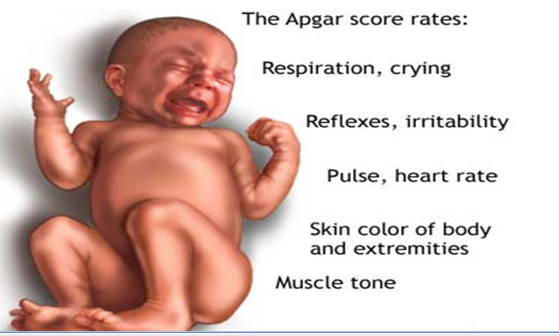
APGAR Score

Slide 6
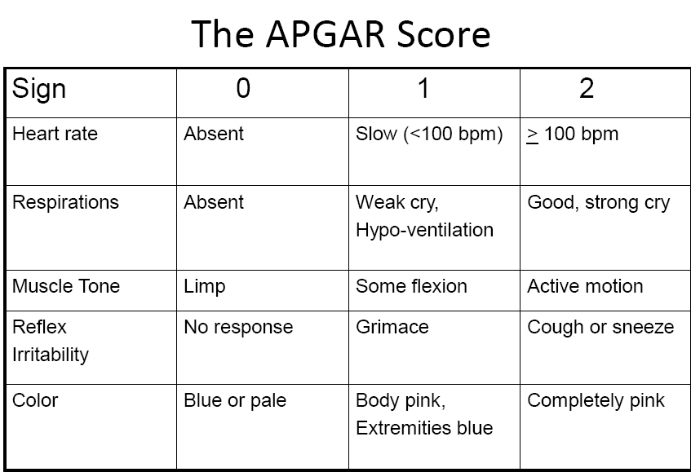

Slide 7
Essential new born care

Slide 8
Essential newborn Care
Essential newborn care is care given to all newborn infants at birth to optimize their chances of survival
  Step 1: Dry and Stimulate
  Step 2: Evaluate Breathing
  Step 3: Cord care
  Step 4: Keep the newborn warm (Prevent Hypothermia)
  Step 5: Initiate breastfeeding in the first one hour
  Step 6: Administer eye drops/eye ointment
  Step 7: Administer vitamin K Intramuscularly (IM)
  Step 8: Place the newborn’s identification bands on the wrist and ankle
  Step 9: Weigh
  Step 10: Document

Slide 9
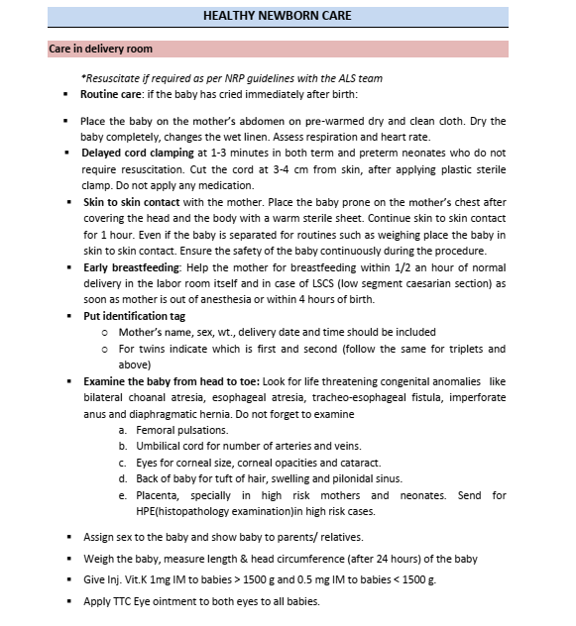

Slide 10
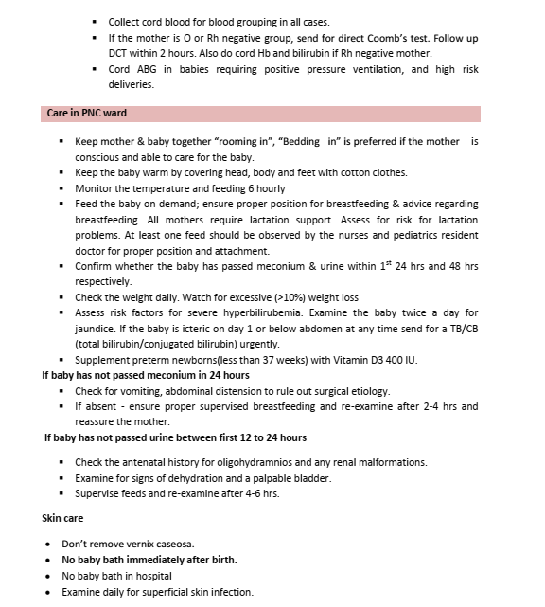

Slide 11
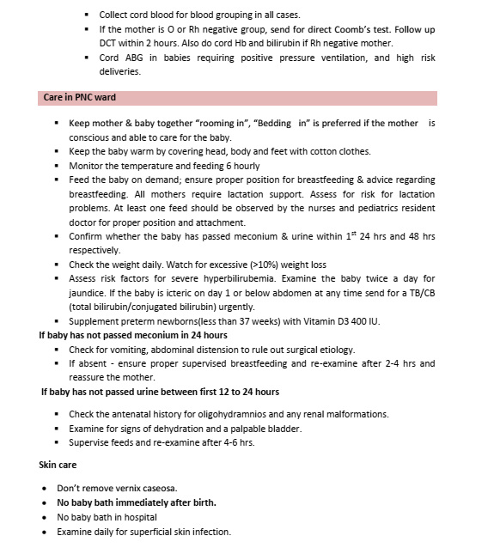

Slide 12
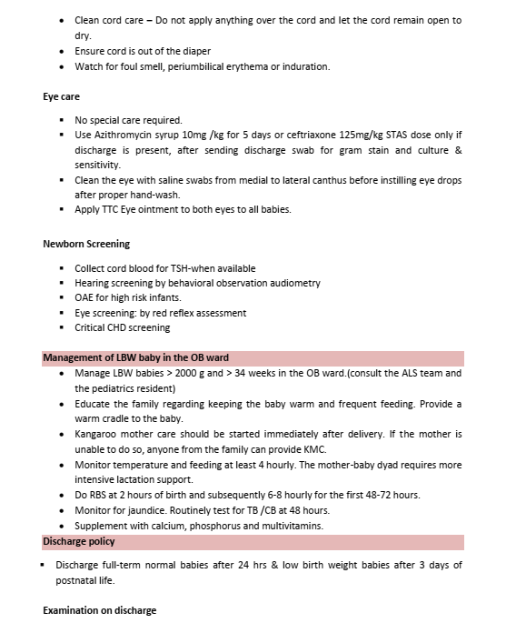

Slide 13
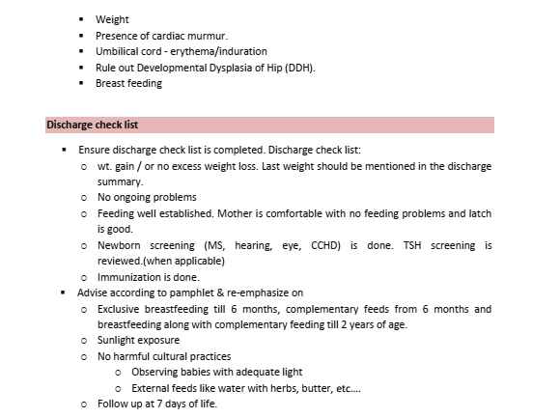

Slide 14
Neonatal resuscitation

Slide 15
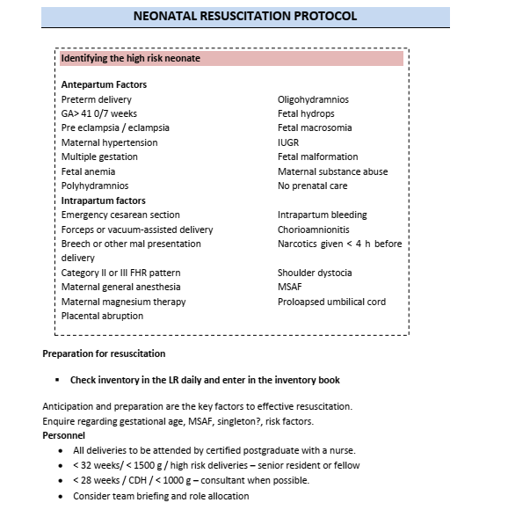

Slide 16
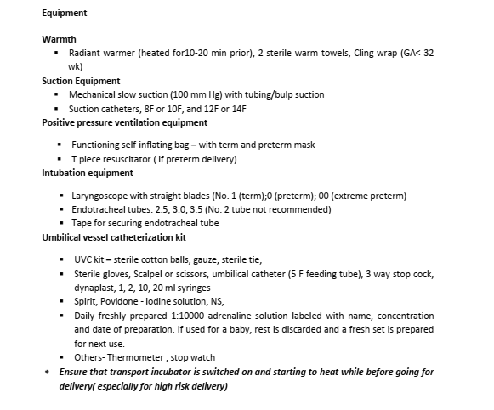

Slide 17
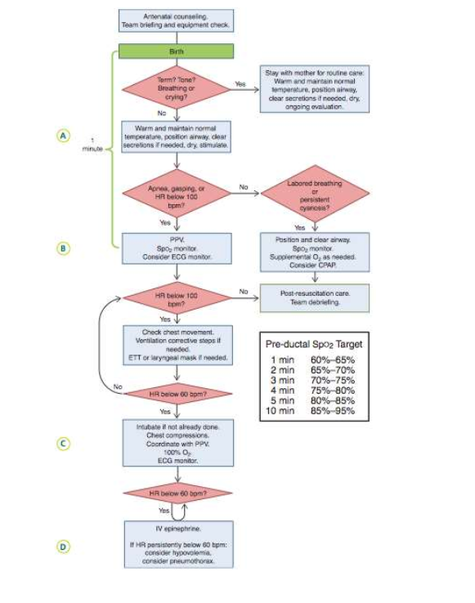

Slide 18
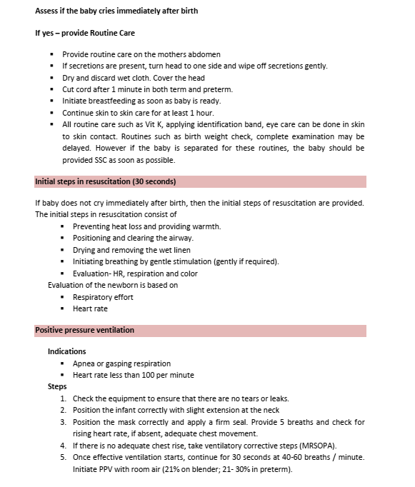

Slide 19
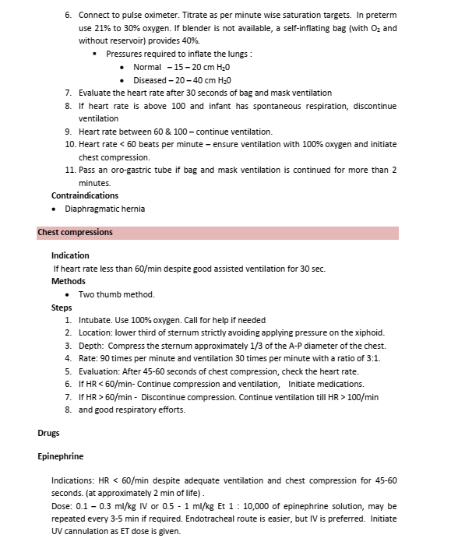

Slide 20
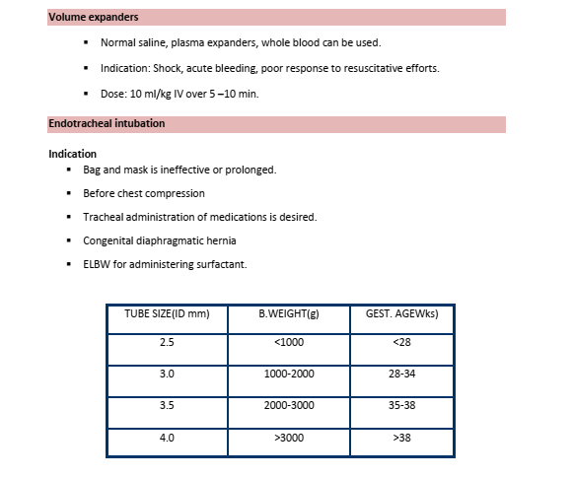

Slide 21
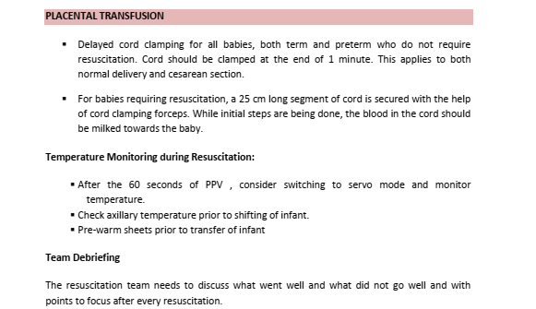

Slide 22
Necrotizing enterocolitis

Slide 23
NEC is the most common life-threatening emergency of the gastrointestinal tract in the newborn period. characterized by various degrees of mucosal or transmural necrosis of the intestine.
Cause of NEC
  remains unclear
  most likely multifactorial
  incidence of NEC is 1-5% of infants in neonatal ICUs.
  incidence and case fatality rates increase with decreasing birth weight and gestational age.
Pathologic findings of NEC
  necrotic segment of intestine
  gas accumulation in the submucosa of the bowel wall (pneumatosis intestinalis)
  progression of the necrosis to perforation,
  peritonitis
  sepsis
  death

Slide 24
The distal part of the ileum and the proximal segment of colon are involved most frequently; in fatal cases, gangrene may extend from the stomach to the rectum.
Although NEC is a multifactorial disease primarily associated with intestinal immaturity, the concept of “risk factors” for NEC is controversial.
This triad has classically been linked to NEC.
  intestinal ischemia
  (injury),
  enteral nutrition (metabolic substrate), and
  bacterial translocation
Prematurity is the greatest risk factor
Rarely occurs before the initiation of enteral feeding and is much less common in infants fed human milk.
Aggressive enteral feeding may predispose to the development of NEC.
Coagulation necrosis is the characteristic histologic finding in intestinal specimens.

Slide 25
History
Although nearly 90% of all cases of NEC occur in preterm infants,
the disease can occur in full-term neonates.
NEC in term infants is often a “secondary” disease,
  more frequently in infants with history of
    birth asphyxia
    Down syndrome
    congenital heart disease
    rotavirus infections
    Hirschsprung disease
Age at onset
Progression
Preterm?
Enteral feeding?
lethargy and temperature instability, abdominal distention, gastric retention
Type of stool,bloody stool
Red cell transfusion
History of
    Birth asphyxia
    Down syndrome
    Congenital heart disease
    Rotavirus infections
    Hirschsprung disease

Slide 26
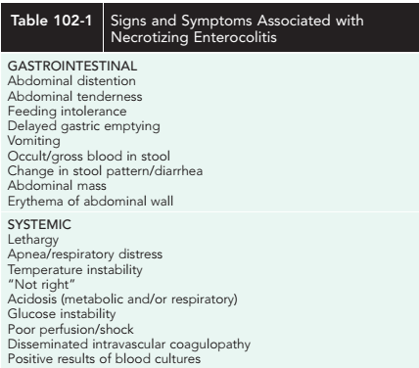

Slide 27
Diagnosis
Differential diagnosis
Very high index of suspicion in treating preterm at-risk infants
Plain abdominal radiographs are essential to make a diagnosis
of NEC
  Pneumatosis intestinalis (air in the bowel wall)
  confirms the clinical suspicion of NEC and is diagnostic;
  50-75% of patients have pneumatosis when treatment is started
Portal venous gas is a sign of severe disease, and pneumoperitoneum
indicates a perforation
Hepatic sonography may detect portal venous gas in some infants with normal abdominal
x-rays.
Gastrointestinal obstruction
Volvulus
Isolated intestinal perforation
Idiopathic focal intestinal perforation can occur spontaneously or after the early use of postnatal steroids and indomethacin.
  Pneumoperitoneum develops in such patients, but they are
  usually less ill than those with NEC.

Slide 28
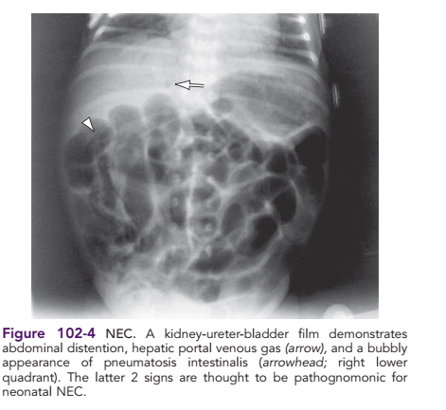
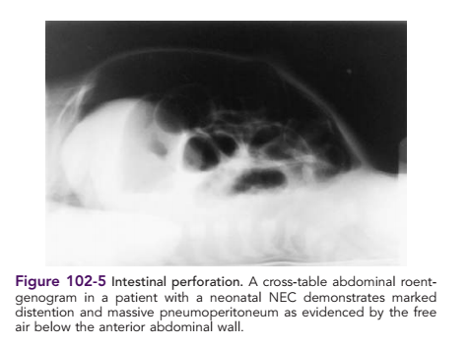

Slide 29
Treatment
Indications for surgery
Rapid initiation of therapy
No definitive treatment for established NEC
  giving supportive care and preventing further injury with
    cessation of feeding,
    nasogastric decompression, and
    administration of intravenous ﬂuids.
Broad spectrum antibiotics
Intravascular volume replacement with crystalloid or blood products
Surgery
evidence of perforation on abdominal x-ray (pneumoperitoneum) or
positive result of abdominal paracentesis (stool or organism on Gram stain preparation from peritoneal ﬂuid)
Failure of medical management,
a single fxed bowel loop on
radiographs,
abdominal wall erythema, and
a palpable mass are relative indications for exploratory laparotomy.

Slide 30
Prognosis
Prevention
Medical management fails in approximately 20-40% of patients with pneumatosis intestinalis at diagnosis; of these, 10-30% die.
Early postoperative in approximately 10% of surgically or medically managed patients.
Preterm infants with NEC who require surgical intervention or who have concomitant bacteremia are at increased risk for adverse growth and neurodevelopmental outcome.
Exclusive breast feeding
Delayed or slow introduction of enteral feeding(controversial)
Prophylactic antibiotics(Controversial)

Slide 31
TORCH

Slide 32
TORCH INFECTIONS
TORCH is an acronym
Toxoplasmosis;
Others.. syphilis, hepatitis B, coxsackievirus, Epstein-barr, varicella-zoster virus (VZV), and human parvovirus;
Rubella virus;
Cytomegalovirus [CMV] and
Herpes simplex virus [HSV])

Slide 33
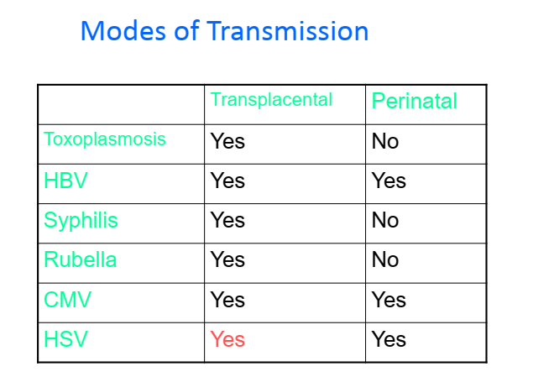

Slide 34
TOXOPLASMOSIS
Risk factors
Intracellular parasitic protozoan
More risk as the pregnancy progresses 17% 1st TM and 65% 3rd TM
The incidence of congenital infection is
    1 in 1000 to 1 in 10,000 live births
T. gondii may be ingested during contact with soil or litter boxes contaminated with cat feces
Unpasteurized milk, in raw or undercooked meats (especially pork)
blood product transfusion (white blood cells)
Prematurity

Slide 35
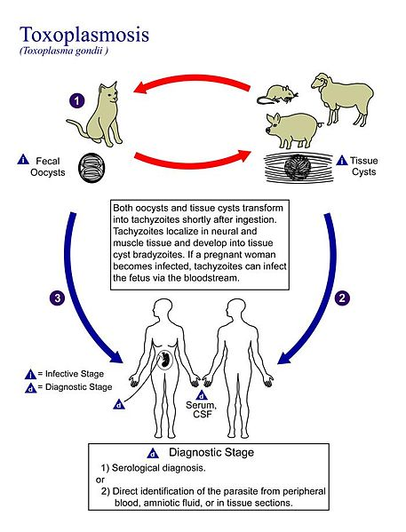

Slide 36
Clinical presentation
Congenital toxoplasmosis may be manifested as
    Clinical neonatal disease
    Disease in the first few months of life
    Late sequelae or relapsed infection or
    Subclinical disease
Disseminated disease
Isolated CNS or ocular disease
Late sequelae are primarily related to ocular or CNS disease
The classic triad of toxoplasmosis
    Obstructive hydrocephalus
    Chorioretinitis, and
    intracranial calcifications form

Slide 37
Diagnosis
clinical suspicion
• Serologic tests:
– IgG(The Sabin-Feldman dye test )
– IgM
– The IgG indirect fluorescent-antibody (IgG-IFA) test.
• PCR
Direct isolation of the organism from body fluids or tissues
Perinatal diagnosis
CSF examination
Radiologic studies
Cranial ultrasonogram or CT scan of the head
Long-bone films may show abnormalities
Ophthalmologic examination

Slide 38
Treatment
Complication
o Pyrimethamine
o Sulfadiazine
o Folinic Acid
• Spiramycine
• In case of signs of acute inflammation:
– Corticosteroids (Prednisolone)
Blindness or severe visual disability
• Severe mental retardation
Other neurological manifestations
Prevention
Pregnant women should avoid
    eating raw meat or raw eggs and
    exposure to cat litter boxes or cat feces

Slide 39
RUBELLA
Viral infection capable of causing
  chronic intrauterine infection and
  damage to the developing fetus
Rubella vaccine has virtually eliminated cases of congenital rubella syndrome (CRS) in the developed countries
The risk for congenital defects and disease is greatest with primary maternal infection during the first trimester.
Risk factors
    Women of childbearing age who are rubella nonimmune
Clinical presentation
Wide spectrum of presentations
Teratogenic effects
Systemic involvement
Later-presenting defects, normal at birth
the majority later develop one or more signs and symptoms of disease
S

Slide 40
Diagnosis
Complications may involve many parts of the body.
Triads of congenital rubella
• Cataract
• Patent ductus arteriosus
• Microcephaly
Confirmed by:
• finding rubella-specific IgM antibody in the neonatal serum,or
• culturing rubella virus from the infant (nasopharynx, urine, or
tissues)
• Virus can be shed in the urine for 1 yr or longer
Management
There is no specific treatment for rubella
Long-term follow-up

Slide 41
CYTOMEGALOVIRUS
Risk factotrs
CMV is a DNA virus member of the herpesvirus group
Common cause of congenital infection
Incidence is ~ 0.5-1.5% of all live births
Most CMV infections are inapparent
• but the virus can cause a variety of clinical illnesses that range in
severity from mild to fatal
• CMV is the most common cause of congenital infection
lower socioeconomic status
drug abuse
sexual promiscuity in the mother
Premature
Transfusion with unscreened blood product

Slide 42
Clinical presentation
Subclinical infection is 10 times more common than clinical illness
LBW and SGA even when the infant is not infected
IUGR
Hepatosplenomegaly with jaundice
Abnormal LFTs
Thrombocytopenia with or without purpura
Severe CNS disease in 50-90% of newborn
Microcephaly
Intracerebral calcifications ( subependymal area),
Chorioretinitis
Progressive sensorineural hearing loss (10-20% )

Slide 43
Clinical presentation
Hemolytic anemia
Pneumonitis
By 2 years of age, 5-15% of infants who are asymptomatic at birth may develop serious sequelae
    such as hearing loss or
    ocular abnormalities.
Late sequelae
    mental retardation
    Learning disability and
    sensorineural hearing loss in 7-15% ilateral
    Progressive deterioration.

Slide 44
Diagnosis
cytomegalic inclusion disease
  Hepatosplenomegaly
  Jaundice
  Petechiae
  Purpura
  microcephaly
Active CMV infection is best confirmed by virus isolation from:
o Urine(positive within 48-72 hrs)
o Saliva(positive within 48-72 hrs)
o bronchoalveolar washings
o breast milk
o cervical secretions
o buffy coat or tissues obtained by biopsy.
• PCR
Treatment
– ganciclovir

Slide 45
SYPHILIS
Sexually transmitted infection caused by the spirochete Treponema pallidum
It can cross the placenta at any time during pregnancy
The incubation period is typically about 3 weeks but could range from 9 to 90 days
The disease has three clinically recognizable stages
  Primary syphilis
  Secondary syphilis
  Tertiary syphilis
Risk factors
  lack of prenatal health care
  Maternal illicit drug use (cocaine use)
  No serologic test for syphilis (STS) performed during pregnancy

Slide 46
Clinical manifestation
The early manifestations of congenital infection are varied and
involve multiple organ systems.
▪ Hepatosplenomegaly, jaundice, and elevated liver enzymes
(common).
▪ Lymphadenopathy
▪ Coombs negative hemolytic anemia is characteristic.
▪ Thrombocytopenia
▪ osteochondritis and periostitis -(pseudoparalysis of Parrot)
mucocutaneous rash
Mucous patches
rhinitis (snuffles), and
condylomatous lesions
CNS abnormalities
failure to thrive
chorioretinitis
nephritis, and nephrotic syndrome

Slide 47
• Clinical manifestations of renal involvement include:
o hypertension
o Hematuria
o Proteinuria
o Hypoproteinemia
o hypercholesterolemia, and
o hypocomplementemia.
The late manifestations result primarily from chronic
inflammation of:
• bone
• teeth, and
• the CNS.
• Skeletal changes due to persistent or recurrent periostitis and
associated thickening of bone include:
➢ frontal bossing
➢ a bony prominence of the forehead (“olympian brow”)
➢ unilateral or bilateral thickening of the sternoclavicular portion of the
clavicle (Higouménakis sign)
➢an anterior bowing of the midportion of the tibia (saber shins)

Slide 48
Dental abnormalities are common :
1. Hutchinson teeth (peg or barrel-shaped upper central incisors)
2. abnormal enamel, which results in a notch along the biting surface
3. mulberry molars
➢ Defects in enamel formation lead to repeated caries and eventual tooth
destruction.
• A saddle nose (depression of the nasal root) is a result of syphilitic rhinitis
that destroys the adjacent bone and cartilage.
• Rhagades -are linear scars that extend in a spokelike pattern from previous
mucocutaneous fissures of the mouth, anus, and genitalia
Juvenile paresis, an uncommon latent meningovascular
infection, typically presents during adolescence with:
o behavioral changes
o focal seizures, or
o loss of intellectual function.
➢ Juvenile tabes with spinal cord involvement and
➢ cardiovascular involvement with aortitis are rare

Slide 49
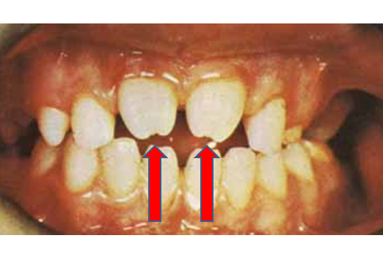
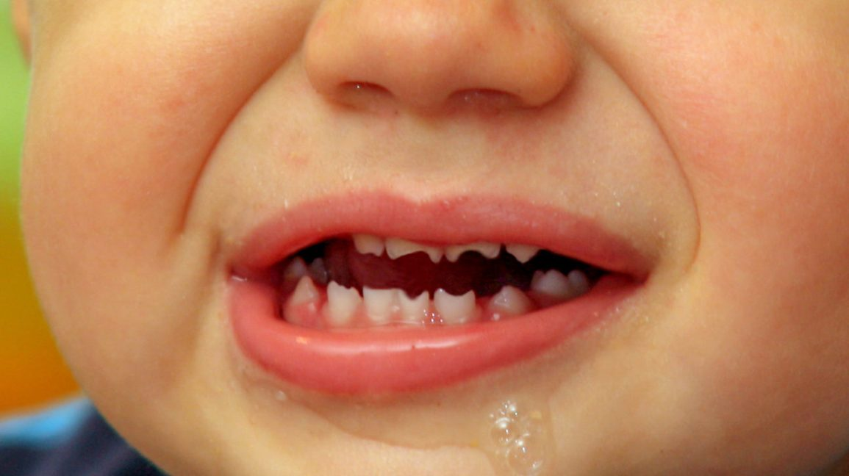
Hutchinson teeth

Slide 50
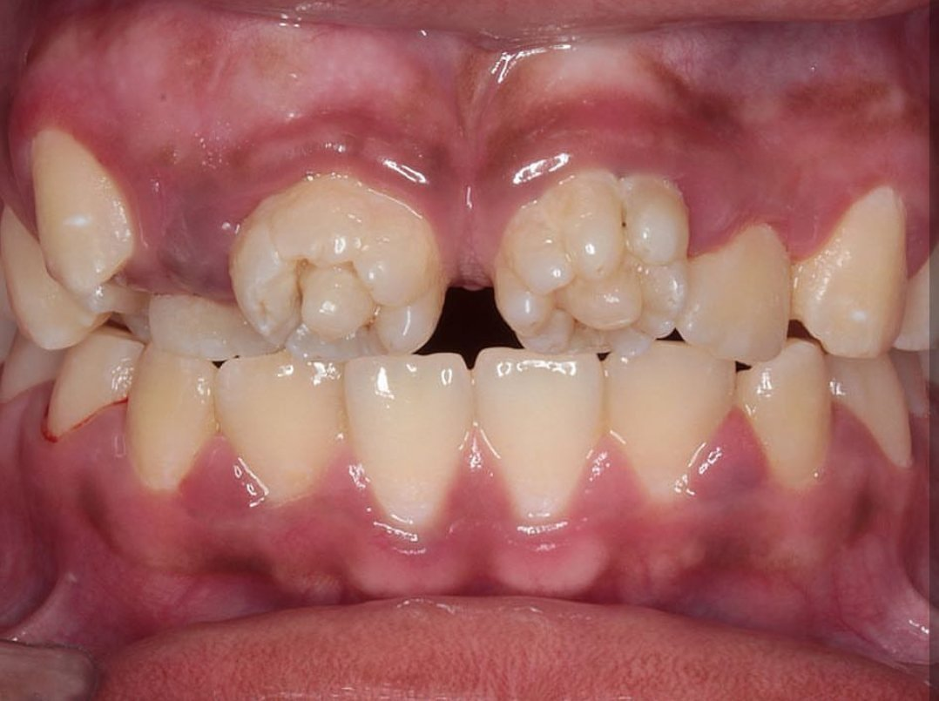
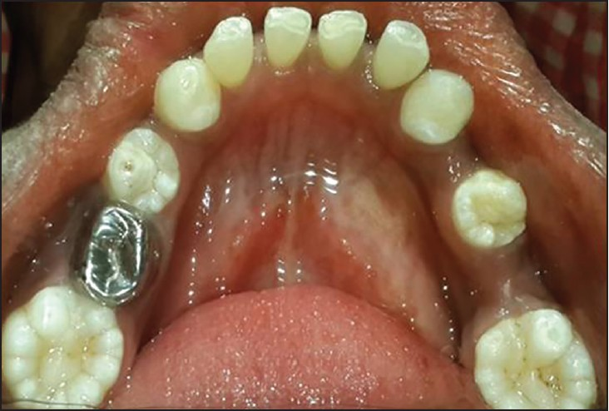
Mulberry molars

Slide 51
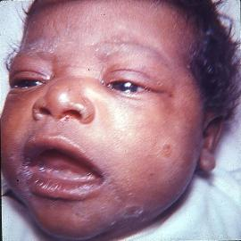
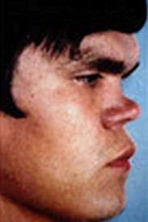
Saddle nose

Slide 52
Diagnosis
Management
Laboratory studies
Nonspecific reagin antibody tests
Specific treponemal tests
Complete blood cell count with differential
Lumbar puncture
X-ray of the long bones
Treat the mother
Treat the infant if maternal treatment was
  Inadequate
  Unknown
  Given during the last 4 weeks of pregnancy or
  Drug used was other than penicillin

Slide 53
Management
For pregnant woman who has been treated for syphilis monthly quantitative NTA tests
VDRL-positive infant treat with
aqueous crystalline penicillin G 100,000-150,000 units/kg/24 h IV, or
50,000 units/kg/day of procaine penicillin IM for 10-14
Aqueous crystalline penicillin G (100,000–150,000U/kg/24hr,
given as 50,000U/kg IV BID for the first 7 days and TID
thereafter) for 10–14 days OR
• Procaine penicillin G (50,000U/kg IM daily in a single dose) for
10–14 days

Slide 54
Isolation Procedures
Precautions regarding drainage, secretions, blood and body fluids are indicated for all infants with suspected or proven congenital syphilis until therapy has been given for 24 h

Slide 55
HSV
Neonatal HSV Infection
• Most cases of neonatal herpes occur:
– due to maternal infection during delivery
– approximately 75% are HSV type 2.
• Maternal primary or first episode genital herpes (no antibody
present against the type of virus ) has an infant attack rate of 33–
50%.
• Recurrent maternal disease has an infant attack rate of only 1–3%
Perinatal infection manifests in the first month of life:
– 9% on the first day, and
– in 40% by the first week.
• Three major categories:
1. localized skin, eye, and mouth infection
2. CNS infection and
3. Disseminated infection.
➢ Symptoms of CNS involvement are found in 48–79% and
include:
o Lethargy
o poor feeding
o Irritability
o poor tone, and
o seizures

Slide 56
Diagnosis
- is based on any two of the following:
1. a compatible clinical pattern
2. isolation of the virus
3. development of specific antibodies and
4. demonstration of characteristic cells, histologic changes, viral
antigen, or HSV DNA in scrapings, CSF, or biopsy material.
➢ The use of PCR analysis of CSF and perhaps blood is critical to diagnose
neonatal HSV infection, especially in the absence of skin lesions.
➢ The sensitivity of CSF PCR in neonatal CNS infection is 75%.
➢Viral culture is gold standard!
➢Microscopic examination of scrapings from lesions (Tzanck
stain) reveals multinuclear giant cells and intranuclear
inclusions approximately 50% of the time.
Treatment
Acyclovir

Slide 57
Hepatitis B
Risk factor
Hepatitis B (serum hepatitis) is caused by a double-shelled DNA virus
It has a long incubation period (45-160 days) after exposure
Factors associated with higher rates of HBV transmission to neonates are:
The presence of HBe antigen and absence of anti-HBe in maternal serum
Maternal acute hepatitis in the third trimester or immediately postpartum (70% attack rate)
Higher-titer HBsAg in maternal serum
Antigenemia present in older siblings
Factors not related to transmission are
  The particular HBV subtype in the mother
  The presence or absence of HBsAg in amniotic fluid
  The presence or titer of anti-HBc in cord blood

Slide 58
Clinical presentation
Maternal hepatitis B infection has not been associated with abortion,stillbirth, or congenital malformations
Prematurity has occurred, especially with acute hepatitis during pregnancy. Fetuses or newborns exposed to HBV present a wide spectrum of disease
Infants are usually asymptomatic
jaundice appears in <3%
Clinical presentations are various
  Chronic active hepatitis with or without cirrhosis
  Chronic persistent hepatitis
  Chronic asymptomatic HBsAg carriage
  Fulminant fatal hepatitis B (rare)

Slide 59
Diagnosis
Differential diagnosis
biliary atresia
acute hepatitis secondary to other viruses (eg, hepatitis A, CMV, rubella, and HSV)
Mother Test for HBsAg, HBeAg, anti-HBe, and anti-HBc.
Infant. Test for HBsAg and anti-HBc-IgM
Transaminases
Bilirubin (direct and indirect)
Liver biopsy
Hepatitis panel testing

Slide 60
Management
Mother is HBsAg-positive, regardless of the status of her Hbe antigen or antibody, the infant should be given hepatitis B immune globulin (HBIG)
  0.5 mL IM, within 12 h after delivery
  hepatitis B vaccine
Recombivax (5 mcg [1.0 mL]) or Engerix (10 mcg [0.5 mL]) IM given at birth and at 1 month and 6 months of age.
Isolation
Precautions are needed in handling blood and secretions
Breast-feeding
HBsAg has been detected in breast milk of HBsAg-positive mothers breast-feeding can be encouraged

Slide 61
Vaccine efficacy
Immunization program
The overall protective efficiency rate in neonates given HBV vaccine and HBIG exceeds 93%.
The HBV-infected neonate is usually asymptomatic but may develop mild clinical hepatitis and usually becomes a chronic carrier
The WHO recommends that all countries add HBV vaccine to their routine childhood immunization program by 1997
Two dose schedules have been proposed
Each includes 3 separate doses
In option 1, at birth, 1-2 months, and at 6-18months
in option 2, at 1-2 months, 4 months, and 6-18 months.

Slide 62
Respiratory Distress in the Newborn
Respiratory distress is a symptom complex arising from disease processes that causes failure to maintain adequate gaseous exchange and it will manifest as:-
  Cyanosis
  Grunting
  Retractions
  Tachypnea
  Nasal flaring
  Extreme: Apnea, Shock
Causes
Respiratory distress syndrome (RDS)
Pneumonia
Meconium Aspiration
Transient Tachypnea
Hypothermia
Hypoglycemia

Slide 63
Laboratory tests
Management
O₂ saturation
X-ray: AP+lateral. Assess both lungs and heart
Blood gas
Hct
Random blood sugar
BP
Transillumination
Hyperoxia test
Nasogastric catheter (radio opaque)
Evaluate for sepsis
Clear airway, esp. meconium
Oxygen
Ventilation
  mask bagging → intubation
  Cyanosis
  CO2 retention
  apnea
Correct Acidosis

Slide 64
Respiratory Distress syndrome
( Hyaline Membrane disease)
Risk factors
Respiratory distress syndrome occurs primarily in premature infants
Incidence is inversely proportional to gestational age and birth weight
60–80% in < 28 wk of gestational age
15–30% in between 32 and 36 wk
5% > 37 wk
Rare at term
Risk is higher in male infants
Infants of diabetic mothers
Delivery before 37 wk gestation
Multifetal pregnancies
Cesarean section delivery
Precipitous delivery
Asphyxia
Cold stress
History of previously affected infants

Slide 65
Decreased risk factors
Chronic or pregnancy-associated hypertension
Maternal opiate addiction
Prolonged rupture of membranes
Antenatal corticosteroid use
Surfactant deficiency
Surfactant:
Phospholipids
Main components:- phosphatidylcholine and phosphatidylglycerol
Other constituents: cholesterol, neutral lipid and other phospholipids

Slide 66
Cont…
In the absence of surfactant:
Progressive collapse of each alveoli during expiration
Decreased compliance (more pressure needed to inflate same volume of air)
Loss of functional residual capacity
Sequence in the premature infant:-
Some surfactant present at birth
Used up quickly
Lungs unable to meet demand for more surfactant
Baby develops progressive collapse of alveoli
Hypoxia and acidosis further inhibit surfactant production, decrease pulmonary blood flow
Hypoxia results in capillary damage and exudate into alveoli

Slide 67
Differential diagnosis
Clinical presentation
Premature infant
Onset shortly after birth
Grunting
Retractions
Nasal flaring
Cyanosis
Tachypnea
Tachycardia
Hypotension
Reaches its peak on the third day
Eventually…apnea
Group B streptococcal pneumonia
Cyanotic congenital heart disease
Persistent pulmonary hypertension
Aspiration syndromes
Congenital anomalies of the lung
Air leak syndrome

Slide 68
Diagnosis
Blood gas features
Acidosis
  Metabolic (low HCO3, low Base Excess)
  Respiratory (High pCO2)
Hypercarbia
  Represents hypoventilation
Hypoxia
Radiographic features
Poorly inflated lungs
Hazy background, ground glass pattern
Reticulo-granular patter (clumps of collapsed alveoli
Air bronchograms

Slide 69
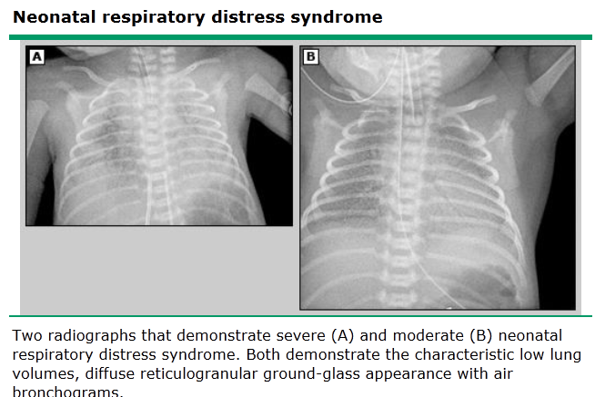

Slide 70
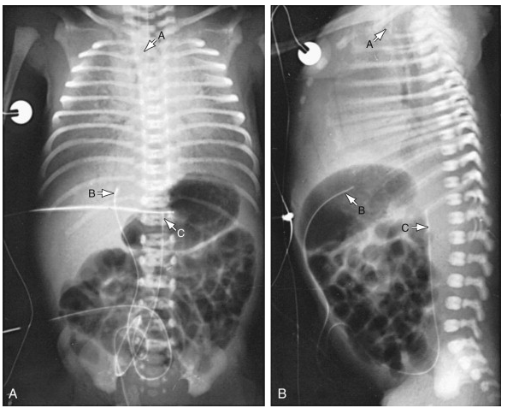

Slide 71
Complications
Air leak (pneumothorax, pneumomediastinum, pulmonary interstitial emphysema, pneumopericardium)
Metabolic acidosis
Hypotension
Hypoxia
Patent ductus arteriosus
Chronic lung disease
Other complications of prematurity (IVH, sepsis, NEC, ROP, etc)
Bronchopulmonary dysplasia
Patent ductus arteriosus
Persistent fetal circulation
Air leak syndrome related to CPAP
Intra ventricular hemorrhage
Necrotizing enterocolitis

Slide 72
Prevention
Treatment
Avoidance of unnecessary or poorly timed early cesarean section(< 39 wk) or induction of labor,
Appropriate management of high-risk pregnancy and labor (including administration of antenatal corticosteroids),
Prediction of pulmonary immaturity with possible in utero acceleration of maturation
Prevention of fetal asphyxia
Early CPAP at delivery room
Prophylactic or early rescue surfactant
Oxygen
Continuous positive airway pressure (CPAP)
Mechanical ventilation with positive end expiratory pressure (PEEP)
Surfactant (endotracheal administration)
In severe cases, nitric oxide, high frequency ventilation
Aims of therapy:
  pH >7.25
  pO2 50-70 mmHg
pCO2 50-60 mmHg (moderateEarly supportive treatment of hypoxia, acidosis, hypotension and hypothermia
Cause we can’t rule out infection initiation of antibiotics is warranted
  hypercapnea)

Slide 73
Complications of prematurity
Acute
Late onset
Respiratory distress syndrome (HMD)
Hypothermia
Hypoglycemia
Sepsis
Necrotizing enterocolitis
Intraventricular hemorrhage
Retinopathy of prematurity
Pathologic jaundice
Anemia of prematurity
Retinopathy of prematurity
Bronchopulmonary dysplasia
Developmental delay
Mental retardation
Hearing and vision deficit
Patent ductus arteriosus

Slide 74
Management
Follow up
1. Manage HMD using CPAP, surfactant
2. Treat hypoglycemia via 10% d/w then early priming of breast milk
3. Incubators to control body temperature
4. Follow for other complications like ROM, Jaundice, NEC, IVH and PDA
5. Advise mother to start KMC
6. Breast and preterm formula for optimal growth
Follow weight gain at least 15-20gm/kg/day
Follow for head circumference 1cm/wk
Anthropometic measurement using corrected age
Vision assessment
Hearing assessment
Brain ultrasound
Development assessment
Assess for anemia, rickets and bleeding tendencies

Slide 75
Complications of post term

Slide 76
Fetal macrosomia

Slide 77
Feeding practices
Infant and young child feeding:
  Exclusive breast feeding:
    the baby is given only breast milk and nothing else.
    Should be practiced during the first six month.
    Breast milk provides best and complete nourishment to the baby during the first six months.
Ingredient | amount
Calorie | 67kcal/dl
Protein | 1.8-3.1gm/dl
whey | 70%
casein | 30%
nucleotides | Present
Lipid | 50% of the calorie in the milk
vitamins
minerals

Slide 78
Feeding…
Advantage of breast milk:
  Improved gastrointestinal function, digestion, and absorption
  Improved cognitive and visual development
  Improved host defense
  Enhanced maternal psychological well-being and maternal-infant bonding.
  Increase the rate of gastric emptying .
  Increase the intestinal lactase activity in premature infants.
  Decrease the intestinal permeability early in life in premature infants .
  Decrease the risk of NEC in premature infants.
Advantage of breast milk(continued)
  Acceleration of uterine involution.
  Reduction of maternal response to stress
  Lower rates of maternal neglect and child abuse
  Enhanced weight loss after pregnancy.
  Prolongation of postpartum anovulation.
  Economic benefit.

Slide 79
Feeding…
Signs of good attachment in breast feeding:
  Mouth wide open
  The lower lip is turned outward
  The chin is touching the breast
  More areola above than below
Positions when breast feeding:
  The cradle hold
  The cross cradle hold
  The seated position
Signs of good positioning:
  The baby's stomach should touch the mother’s abdomen.
  the baby’s body should be straight.
  The baby’s body has to be supported.

Slide 80
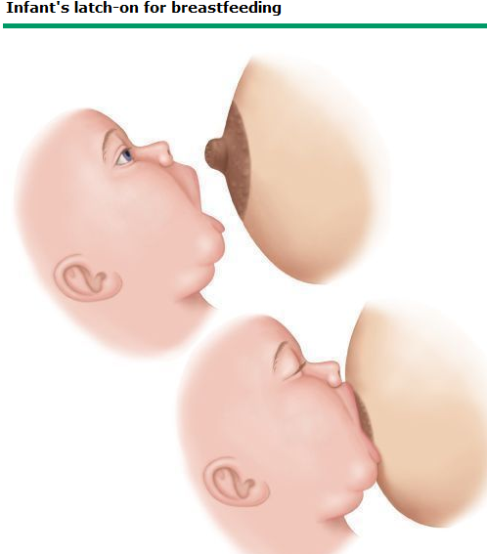
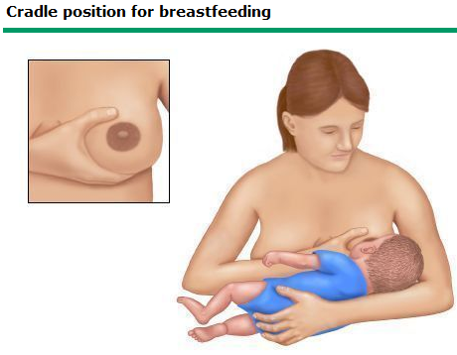
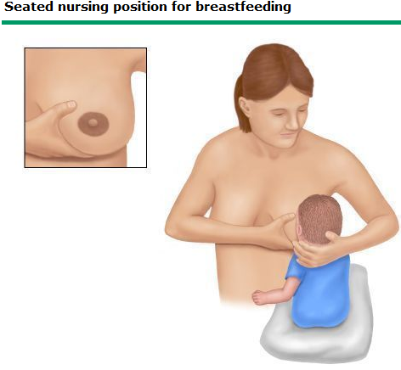
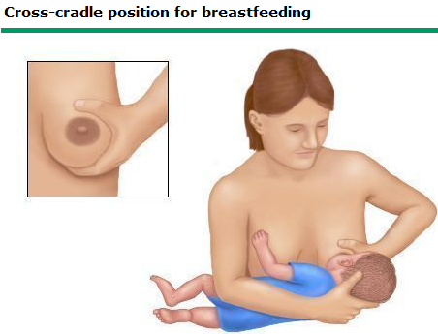

Slide 81
Feeding…
Assessment of breast milk intake adequacy:
  nurses 8 to 12 times in 24 hours
  Infant urinate six to eight times daily
  Passes three or more pale yellow and seedy stools daily.
  Will have adequate weight gain.
Complementary feeding:
  Importance of complementary feeding:
    Is essential from six months of age while continuing breast feeding.
    The purpose is to complement breast milk to provide enough energy, protein and other nutrients.
    Breast feeding has to be continued up to the age of two years or beyond.
    Active feeding style for complementary feeding is important.

Slide 82
Feeding…
First food for the baby:
  Cereal food is recommended
  Porridge, milk, ground rice, fitfit, smashed potato, smashed vegetables, fruits…
  Adding ghee or oil is good as it increases the energy value of the food.
  Gradually egg, meat and fish can be introduced.
Energy density of food can be increased by:
  By adding ghee or oil to the food
  By adding sugar to the food
  By feeding thick mixtures

Slide 83
Feeding…
Frequency of feeding:
  Infants and young children need to be fed 5-6 times a day in addition to breast feeding.
  Inadequate feeding is the most common cause of malnutrition.
Feeding during and after illness:
  One or two extra meals has to be given during this time.

Slide 84
Neonatal hyperbilirubinemia

Slide 85
Etiology
Clinical feature
Unconjugated hyperbilirubinemia may be caused by:
  increased load of bilirubin to be metabolized by the liver
  damage or reduced activity of the transferase enzyme
  competing or blocking the transferase enzyme (drugs)
  absence or decreased amounts of the enzyme (genetic defect, and prematurity).
apparent in a cephalocaudal progression:
  jaundice of face ≈5 mg/dL
  mid-abdomen ≈15 mg/dL
  soles, ≈20 mg/dL
Infants may present with lethargy and poor feeding.
without treatment, can progress to acute bilirubin encephalopathy (kernicterus).

Slide 86
Classification of jaundice
Physiologic jaundice | Pathologic jaundice
Jaundice appearing after 24hr | Appears in the first 24hrs of life
Rate of rise is <5mg/dl/24hr | >5mg/dl/24hr rate of rise
TSB <12mg/dl for term and <15mg/dl for preterm | TSB is >12mg/dl for term and >12mg/dl for preterm
Jaundice doesn’t persist more than 2weeks | Jaundice persists after 2weeks
Direct bilirubin is <2mg/dl | Direct bilirubin is >2mg/dl

Slide 87
Differential diagnosis
Jaundice with in the first week:
  erythroblastosis fetalis
  concealed hemorrhage
  Sepsis
  congenital infections
  Crigler Najjar syndrome
  polycythemia
after the 1st wk of life:
  breast milk jaundice
  Septicemia
  congenital atresia or paucity of the bile ducts
  Hepatitis
  Galactosemia
  Hypothyroidism
  RBC morphology and enzyme deficiencies
Notes:
The most common causes of unconjugated hyperbilirubinemia are bilirubin overproduction, Gilbert's syndrome, and neonatal jaundice. This topic review will discuss unconjugated hyperbilirubinemia due to the rare inherited Crigler-Najjar syndromes. The other disorders are presented separately as is an approach to the patient with jaundice.
CLASSIFICATION — Crigler-Najjar syndrome, also referred to as congenital nonhemolytic jaundice with glucuronosyltransferase deficiency, is a rare, autosomal recessive disorder of bilirubin metabolism. It has been divided into two distinct forms (types I and II) based upon the severity of the disease (table 1).
Type I disease is associated with severe jaundice and neurologic impairment due to bilirubin encephalopathy that can result in permanent neurologic sequelae (kernicterus).
Type II disease is associated with a lower serum bilirubin concentration and affected patients survive into adulthood without neurologic impairment.

Slide 88
Differential diagnosis...
persistent jaundice during the first month of life:
  Hepatitis
  congenital infections
  congenital atresia of the bile ducts
  Galactosemia(genetic disease (autosomal recessive) in which an enzyme needed to metabolize galactose is deficient or absent; typically develops shortly after birth)
  inspissated bile syndrome following hemolytic disease of the newborn.
Investigations
direct and total bilirubin
Hemoglobin/hematocrite
reticulocyte count
blood type
Coombs test
peripheral blood smear
If direct hyperbilirubinemia, investigate for underlying factors

Slide 89
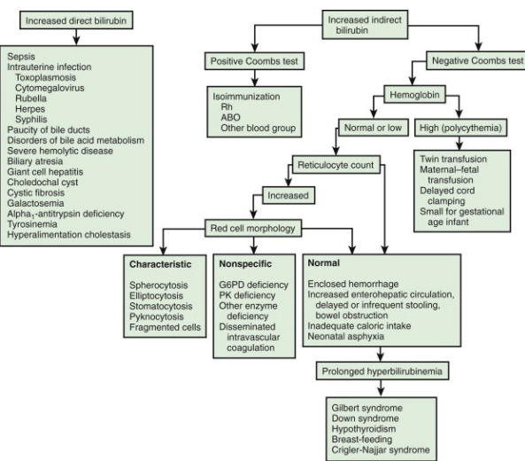
Differential diagnosis…

Slide 90
Bilirubin associated with breast feeding
Breast milk jaundice:
  develops in an estimated 2% of breast-fed term infants after the 7th day of life.
  If nursing is discontinued, the serum bilirubin level falls rapidly.
  may be attributed to the presence of glucuronidase in some breast milk.
Breast feeding jaundice:
  occurs in the 1st week of life.
  may be due to decreased milk intake with dehydration.
  Frequent breast-feeding is the treatment.

Slide 91
Hemolytic disease of the newborn (erythroblastosis fetalis)
caused by the transplacental passage of maternal antibody active against paternal RBC antigens of the infant.
Pathogenesis:
  When Rh-positive blood is infused into an Rh-negative woman, antibody formation against D antigen may be induced in the unsensitized Rh-negative recipient mother.
  IgG antibody readily crosses the placenta to cause hemolytic manifestations.
  Hemolytic disease rarely occurs during a first pregnancy because transfusion of Rh-positive fetal blood into an Rh-negative mother occurs near the time of delivery.
  The severity of Rh illness worsens with successive pregnancies.

Slide 92
Rh incompatibility…
Clinical features:
  Severity ranges from mild hemolysis to severe anemia.
  Jaundice on the first day of life.
  Enlargement of liver and spleen.
  anemia
  signs of cardiac decompensation
  anasarca
  hydrops fetalis- excessive abnormal fluid in two or more fetal compartments.
  Investigatin
  direct Coombs test is usually positive
  Anemia
  blood smear - polychromasia and reticulocyte count is increased.
  Thrombocytopenia- in severe cases
  Cord bilirubin is generally between 3 and 5 mg/dL

Slide 93
Rh incompatibility…
Antenatal diagnosis:
  Maternal sensitization
  Doppler ultrasonography of the middle cerebral artery
  percutaneous umbilical blood sampling (PUBS)
  U/S signs of hydrops
  Unborn infant- transfusion
  Live born infant:
    If severe hemolytic anemia- immediate resuscitation and supportive therapy, temperature stabilization, and monitoring.
    exchange transfusion
    Phototherapy
    IVIG

Slide 94
Rh incompatibility…
Prevention of Rh sensitization:
  Sensitization reduced to less than 1% by the IM injection of 300 ug of human anti-D globulin.
  anti-D administration at 28-32 wk and again at birth (40 wk) is more effective than a single dose.

Slide 95
ABO incompatibility
is the most common cause of hemolytic disease.
results in milder disease than Rh incompatibility does.
Low antigenicity of the ABO factors in the fetus and newborn infant may account for the low incidence of severe ABO hemolytic disease.
the mother is type O and the infant is type A or B.
Clinical feature:
  Most cases are mild
  infant is not generally affected at birth
  hydrops fetalis is extremely rare
  Rarely, it may become severe, and symptoms and signs of kernicterus develop rapidly.
Treatment:
  Phototherapy
  IVIG
  Exchange transfusion

Slide 96
Complications associated with phototherapy
loose stools, erythematous macular rash, purpuric rash
overheating, dehydration ,hypothermia from exposure, and
bronze baby syndrome
Before phototherapy is initiated, the infant’s eyes should be covered
Body temperature should be monitored
Potential complications from exchange transfusion
  metabolic acidosis, electrolyte abnormalities, hypoglycemia, hypocalcemia,
  thrombocytopenia, volume overload, arrhythmias,
  NEC, infection, graft-versus-host disease, and death.

Slide 97
Hemorrhagic disease of the new born

Slide 98
Hemorrhagic Diseases of the Newborn/HDN
➢ Temporary coagulation defect due to vitamin K deficiency
causing spontaneous hemorrhage
Pathophysiology of HDN
o Deficiency of Vitamin K-dependent factors (II, VII, IX, X)
o Common during the 1st 48-72hrs
o Vitamin K deficiency occurs due to:
▪ Poor source from the mother (placental, Breast milk)
▪ Absence of bacterial flora in the newborn’s intestine
▪ Immaturity of newborn’s liver
Investigations
• Prothrombin Time(PT)--proplnged
• aPTT--prolonged
• Clotting time—prolonged
• Reduced vitamin k –dependent factors
• Normal BT, Platelet and fibrinogen
Treatment
o Vitamin K 1mg Im at birth (prophylaxis)
o Vitamin K 1-5mg (IV slow infusion)—therapeutic
o Plasma transfusion (severe cases)
Complications
➢Intracranial Bleeding (serious)

Slide 99
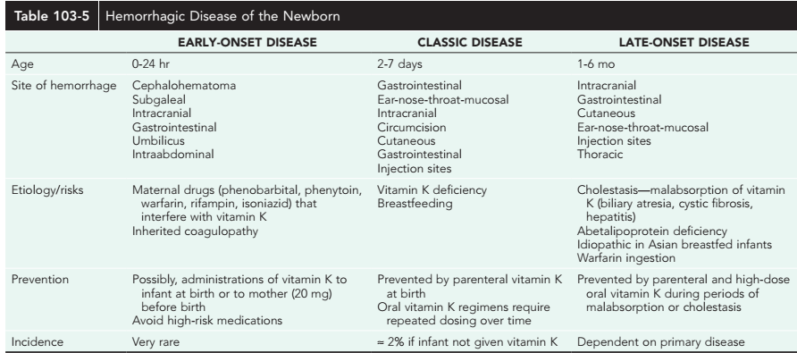

Slide 100
Neonatal Seizures

Slide 101
TYPES OF NEONATAL SEIZURES
There are 5 main neonatal seizure types:
  subtle
  clonic
  tonic
  spasms
  myoclonic.
As a rule seizures, associated with electrographic discharges (epileptic seizures) are,
  Spasms
  focal clonic
  focal tonic
  generalized myoclonic

Slide 102
Subtle Seizures
Subtle seizures include
  transient eye deviations,
  nystagmus
  blinking
  mouthing,
  abnormal extremity movements (rowing, swimming, bicycling, pedaling, and stepping),
  fluctuations in heart rate,
  hypertension episodes, and
  apnea.
Subtle seizures occur more commonly in premature than in full-term infants.

Slide 103
Seizures vs Jitteriness
Jitteriness can be defined as rapid motor activities, such as a tremor or shake
can be ended by flexion or holding the limb.
Seizures, on the other hand, generally do not end with tactile or motor suppression.
Jitteriness, unlike most seizures, is usually induced by a stimulus.
Also unlike jitteriness, seizures often involve eye deviation and autonomic changes

Slide 104
Treatment
A mainstay in the therapy of neonatal seizures is
  the diagnosis
  treatment of the underlying etiology (e.g., hypoglycemia, hypocalcemia, meningitis, drug withdrawal, trauma), whenever one can be identified
Phenobarbital is considered by many as the first choice long-acting drug in neonatal seizures.
The usual loading dose is 20 mg/kg.
For ongoing seizures, if a total loading dose of 40 mg/kg of phenobarbital was not effective,
then a loading dose of 15-20 mg/kg of phenytoin can be administered intravenously.
Notes:
If this dosage is not effective, then additional doses of 5-10 mg/kg can be given until a dose of 40 mg/kg is reached.
Respiratory support may be needed after phenobarbital loading
Thus, standard phenobarbital dosing in premature infants has the potential for higher serum levels and resultant toxicity. As the infant becomes older, identical daily maintenance doses may result in lower serum levels and create the potential for breakthrough seizures with no other change in the infant's clinical condition. Overall, monitoring trends of serum levels rather than day-to-day fluctuations are more useful in management of phenobarbital therapy

Slide 105
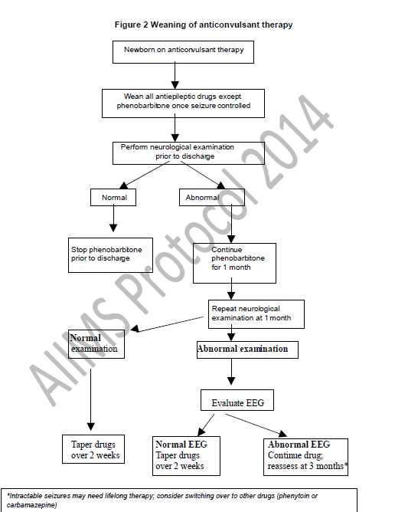
Duration of Therapy

Slide 106
Management
The goal is to stop electrographic seizure activity before reducing the therapy
Principles of management
  Treat life threatening conditions
  Treat the acute seizure
  Treat the underlying cause
  Prevent recurrence
  Prevent and treat systemic complications

Slide 107
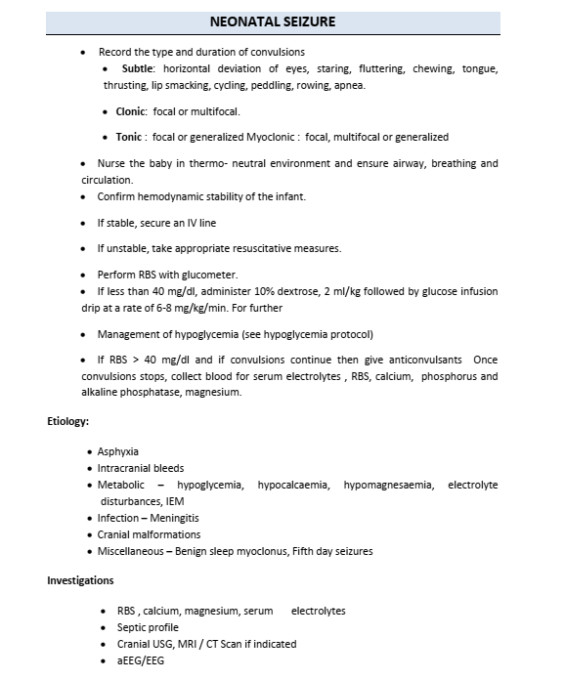

Slide 108
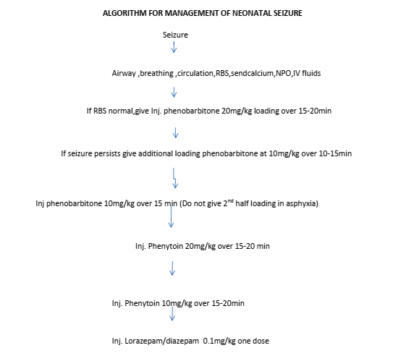

Slide 109
Cleft lip and palate

Slide 110
Cleft Lip and Palate
Clefts of the lip and palate are distinct entities closely related embryologically, functionally, and genetically.
A cleft lip or palate is an abnormal separation in the oral-facial region that happens because tissue of the mouth or lip does not form correctly in fetal development.
resulting in a failure of the medial nasal and maxillary processes to join.
Cleft of the palate appears to represent failure of the palatal shelves to approximate or fuse
The incidence of cleft lip with or without cleft palate is ≈1/750 white births;
the incidence of cleft palate alone is ≈1/2,500 white births.
Clefts of the lip are more common in males.
Possible causes include
  maternal drug exposure,
  a syndrome-malformation complex, or
  genetic factors.
    the recurrence risk is 50%.
Notes:
Clefts of the lip and palate are distinct entities closely related embryologically, functionally, and genetically. Although there are a variety of theories, it is commonly thought that cleft of the lip appears because of hypoplasia of the mesenchymal layer, resulting in a failure of the medial nasal and maxillary processes to join. Cleft of the palate appears to represent failure of the palatal shelves to approximate or fuse.

Slide 111
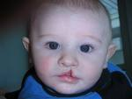
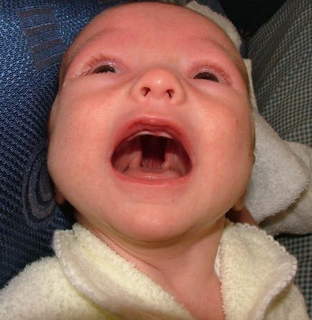
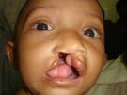
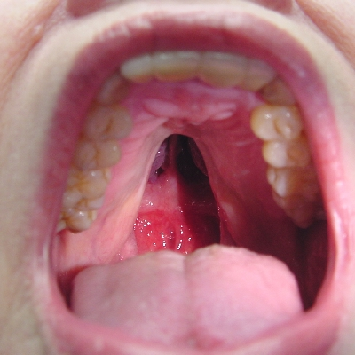
Cleft Lip and Palate…

Slide 112
Cleft Lip and Palate:
Clinical features
  Functional Impairment
    Suckling, Swallowing, Speech, Hearing, Malocclusion
  Separation of the lip
  Separation of the palate (roof of the mouth)
  Nasal distortion
  Recurring ear infections
  Failure to gain weight
  Nasal regurgitation when bottle feeding
  Poor speech
  Misaligned teeth
  Growth retardation
  Ear infections
  Hearing loss
  Dental cavities
  Displaced teeth
  Poor speech
  Lip deformities
  Nasal deformities

Slide 113
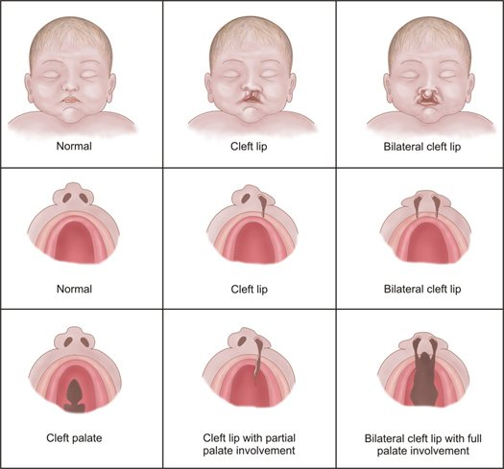
Treatment
Feeding
  use of soft artificial nipples with large openings, a squeezable bottle (Mead Johnson bottle!)
Surgical closure of the cleft lip
  by 3 mo of age, when the infant has shown satisfactory weight gain
  The initial repair may be revised at 4 or 5 yr of age
  Nasal surgery can also be performed at the time of the lip repair.
Cleft palate
  The goals of surgery are the union of the cleft segments, intelligible and pleasant speech, reduction of nasal regurgitation, and avoidance of injury to the growing maxilla
  the timing of surgical correction should be individualized but advised to be done before 1 year to enhance normal speech development

Slide 114
Tracheoesophageal Fistula
Incidence
  EA and TEF are relatively common congenital anomalies
  ˜1 in 4500 live births
  Male=Female
  0.5% - 2% increase risk in newborns with one affected sibling
  Risk increases to 20% if more than one sibling is affected
Embryologically,
Derived from primitive foregut
4thweek of gestation tracheoesophageal diverticulum forms from the laryngotracheal groove
Tracheoesophageal septum develops during 4th-5thweeks –muscular + submucosal layer of T + E formed
Elongates with descent of heart and lung
7thweek reaches final length

Slide 115
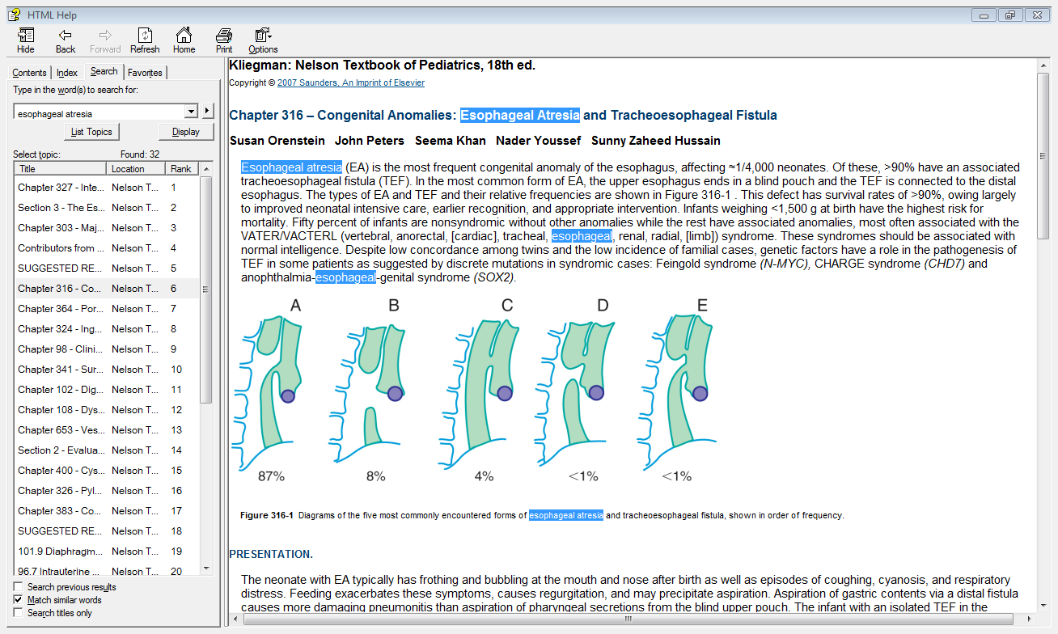
Types of tracheoesophageal abn.

Slide 116
Types of tracheoesophageal abn.
85% are Distal TEF
8% are Pure atresia
4% are H-type fistula
Proximal fistula is the least common

Slide 117
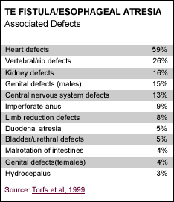
Associated Anomalies
VACTERL: vertebral, anal, cardiac, TE, renal, limb
Congenital heart disease is associated with higher mortality
  VSD is most common
  ASD
  Tetralogy of Fallot
  PDA
Echocardiogram – important to determine position of aortic arch

Slide 118
Clinical Features of TEF
  Prenatally
    Predictive value of prenatal ultrasound ~20-40%
    Polyhydramnios (2/3 cases)
    Small or absent stomach bubble
  Postnatal-
    Most infants are symptomatic within the first few hours of life
    Excessive salivation
    Regurgitation of first feed
    Cyanosis with/without feeds
    Respiratory distress
    Inability to pass a catheter into the stomach
    Gastric distention (with distal fistula)

Slide 119
Diagnosis of TEF
  Failure to pass NG tube (not the H type)
  CXR- tube coiled in upper esophagus
  “Pouchogram” with air
  Distal air on AXR confirms the presence of a fistula
  H-type fistulas are often diagnosed later
    May present with recurrent pneumonia
    Delay in diagnosis ranged from 26 days to 4 years.

Slide 120
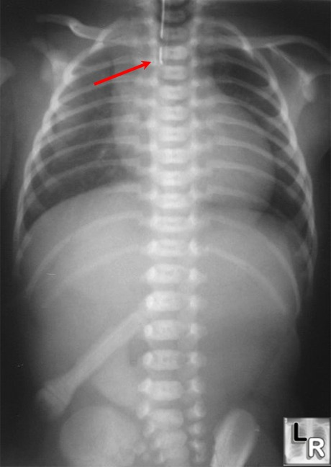
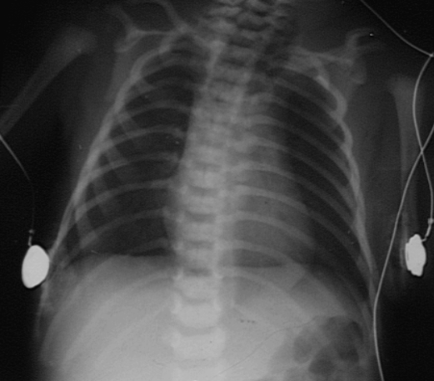
Diagnosis
Confirm with AP chest x-ray that demonstrates the catheter curled in the upper esophageal pouch.
Abdominal XR can help distinguish esophageal blind pouch (no gastric air) from distal TEF (gastric air)

Slide 121
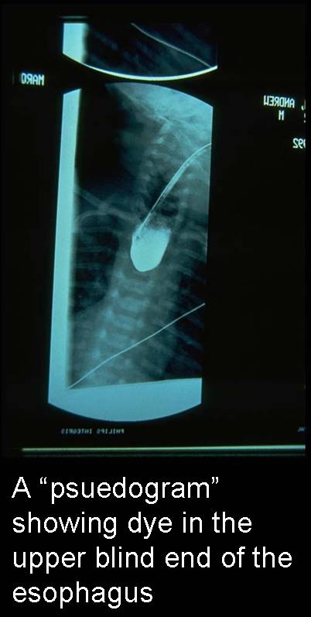
Diagnosis
When diagnosis is uncertain or proximal TEF is suspected, a small amount of water-soluble contrast material can be injected into the esophageal pouch under fluoroscopic guidance (must remove contrast material immediately to avoid regurgitation and aspiration)

Slide 122
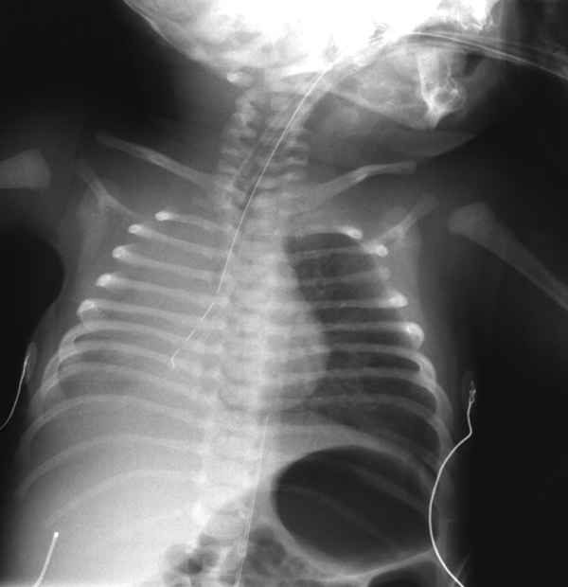
Diagnosis- Type E “H type” TEF

Slide 123
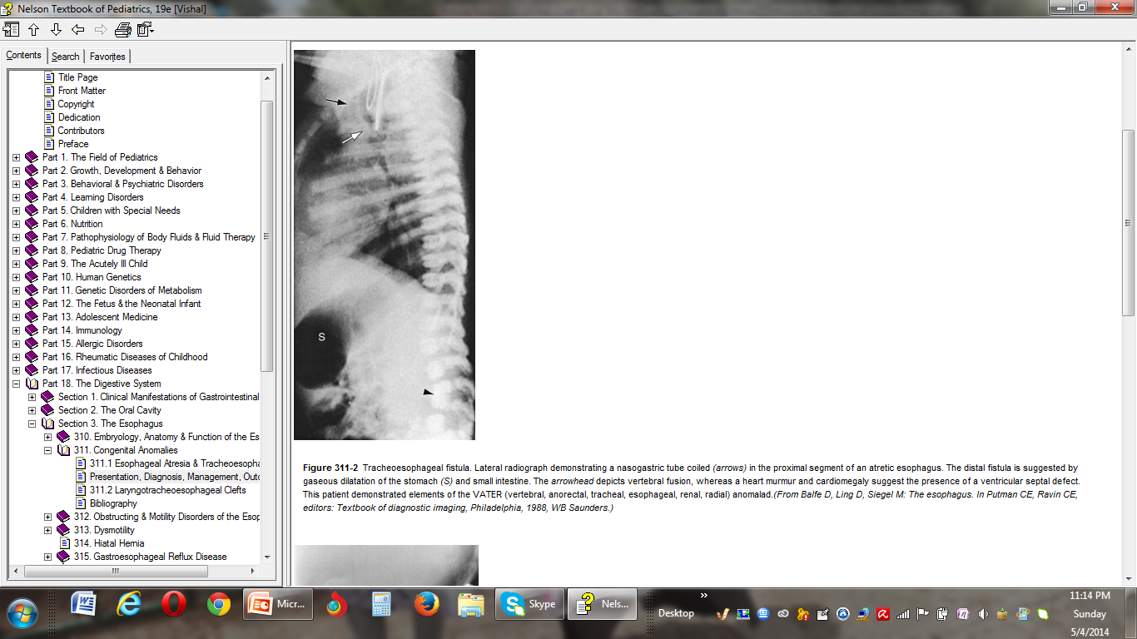
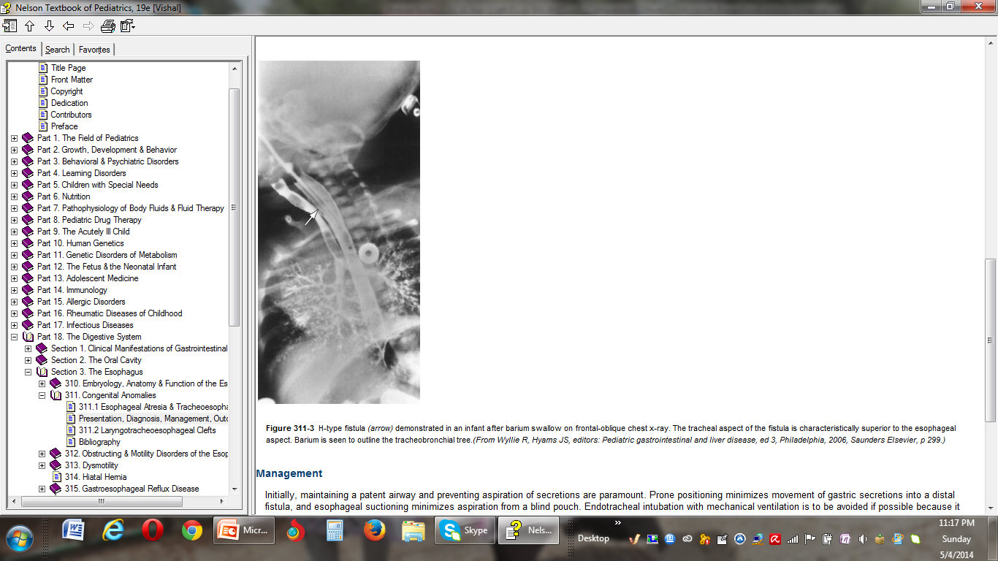
Notes:
Tracheoesophageal fistula. Lateral radiograph demonstrating a nasogastric tube coiled (arrows) in the proximal segment of an atretic esophagus. The distal fistula is suggested by gaseous dilatation of the stomach (S) and small intestine. The arrowhead depicts vertebral fusion, whereas a heart murmur and cardiomegaly suggest the presence of a ventricular septal defect. This patient demonstrated elements of the VATER (vertebral, anorectal, tracheal, esophageal, renal, radial) anomalad

Slide 124
Trachioesophageal disorder
Management
  Preoperatively
    Minimize complications from aspiration
    Suction blind pouch continuously
    NPO/total parentral nutrition/
    Upright position of child
    Early surgery for short gap atresia
    Long gap atresia may be delayed up to 6-12 weeks
    Long gap atresia should have gastrostomy tube placed for enteral nutrition
  Surgery
    Surgical ligation of the fistula
    Primary anastomosis of the esophageal segments
    Primary repair may not be possible if the distance between esophageal segments is long.
    Staged procedures have been performed that include elongation of the esophagus with circular myotomy, interposition of the colon, and gastric transposition

Slide 125
Post op
Prognosis
    Adequate fluid resuscitation
    Wean ventilator
    No deep tracheal suctioning
    Avoid bag/mask ventilation
    No pacifiers/sucking
    Chest tube remains in place for approximately one week
    Esophagram 1 week post op
85% to 95% survival
Infants with increased risk of morbidity and mortality
  Low birth weight (>1500)
  Major CHD
  Severe associated anomalies
  Ventilator dependency
  Long gap atresia : >3-4 cm, primary repair cannot be done; options include using gastric, jejunal, or colonic segments interposed as a neo -esophagus
Notes:
No reintubation

Slide 126
Outcome
  Complications
    GER 40-70%
    Esophageal stricture 40%
    Anastomotic leak 14-21%
    tracheomalacia
    fistula recurrence
    esophageal dysmotility Disturbed peristalsis and delayed gastric emptying are common

